Slide 1
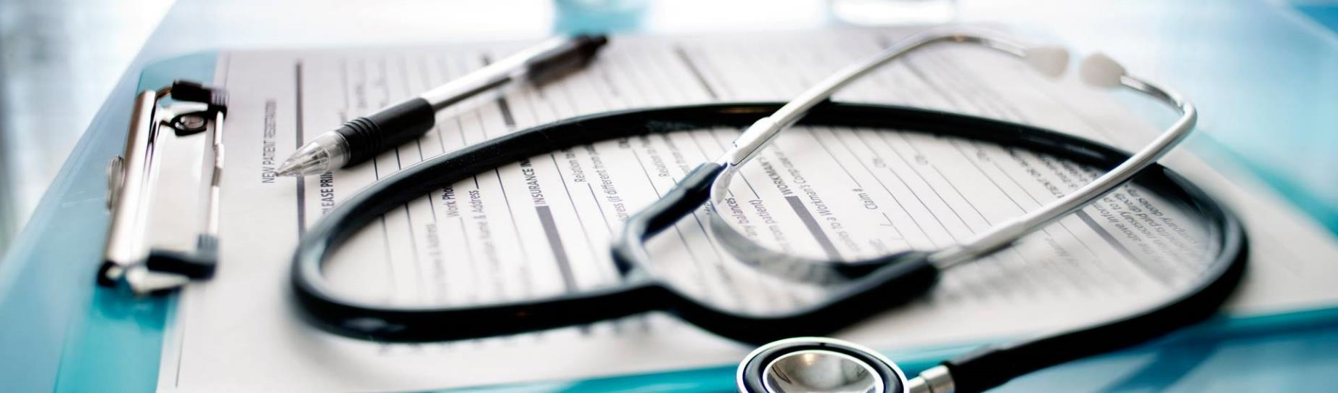
‘Healthmate’: Utilizing Artificial Intelligence for Sustaining a Fast And accurate Healthcare System
Course Name: Senior Design Project
Course Code:CSE499B
Semester: Summer 2021
Section:08
Group:01
Supervisor
Dr. Shahnewaz Siddique
Assistant Professor
Electrical & Computer Engineering, North South University

Slide 2



team
Jaynab Sultana
1721182042
Md. Shofiul Islam
1712698642
Anika Tahsin Meem
1721810642

Slide 3
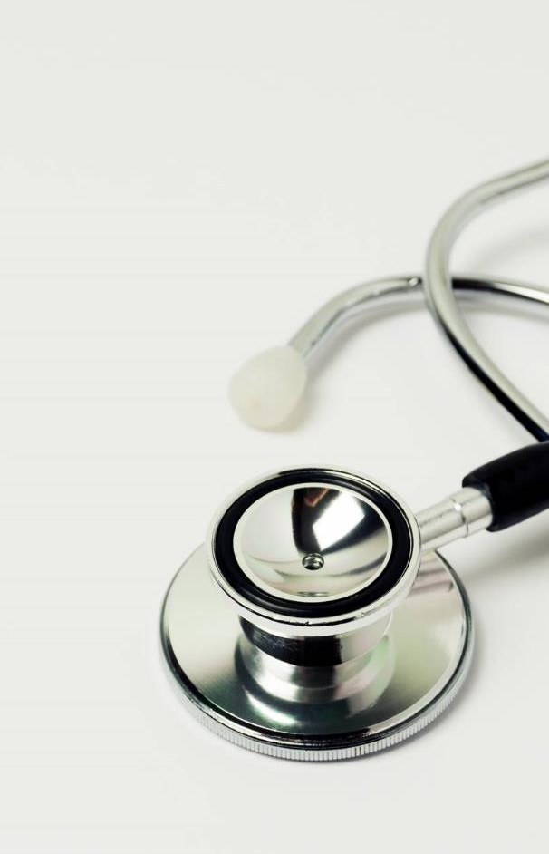
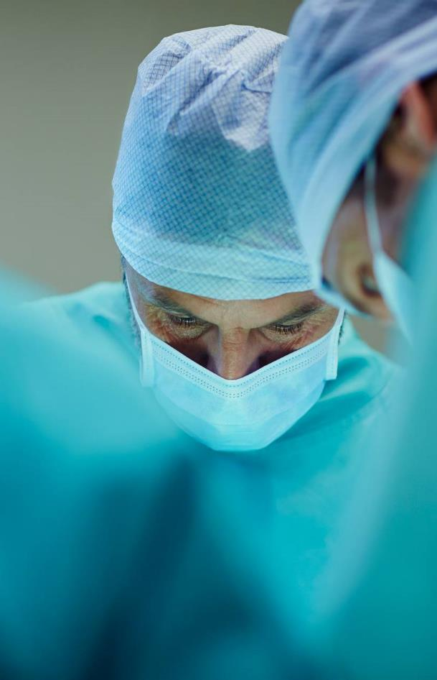
Outline of the presentation
Introduction
Fast and accurate healthcare system
Problem Statements
AI Healthcare Market Size
Objectives
Similar Systems
Major Contributions
System Architecture of the HealthMate
Outcome of Signing in page
Doctor and Patient platform after login.
Proposed model
Tools and Algorithms
Disease Detects
Outcome of the system
Flowchart of the HealthMate system
Summary
Future Work

Slide 4


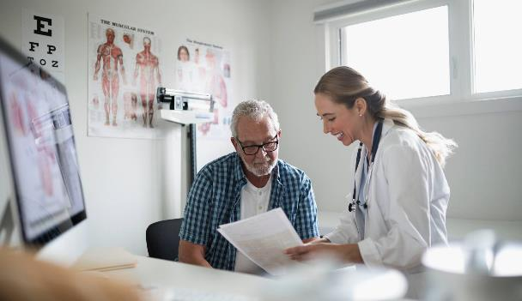
Introduction
With the help of Artificial Intelligence, the lives of patients, doctors and the tasks of hospital administrators have become easier.
The use of artificial intelligence in healthcare is increasing day by day.
Artificial intelligence provides advanced applications in healthcare.
Technological advancement, AI tools and technology have contributed to the rapid growth of AI in healthcare.

Slide 5
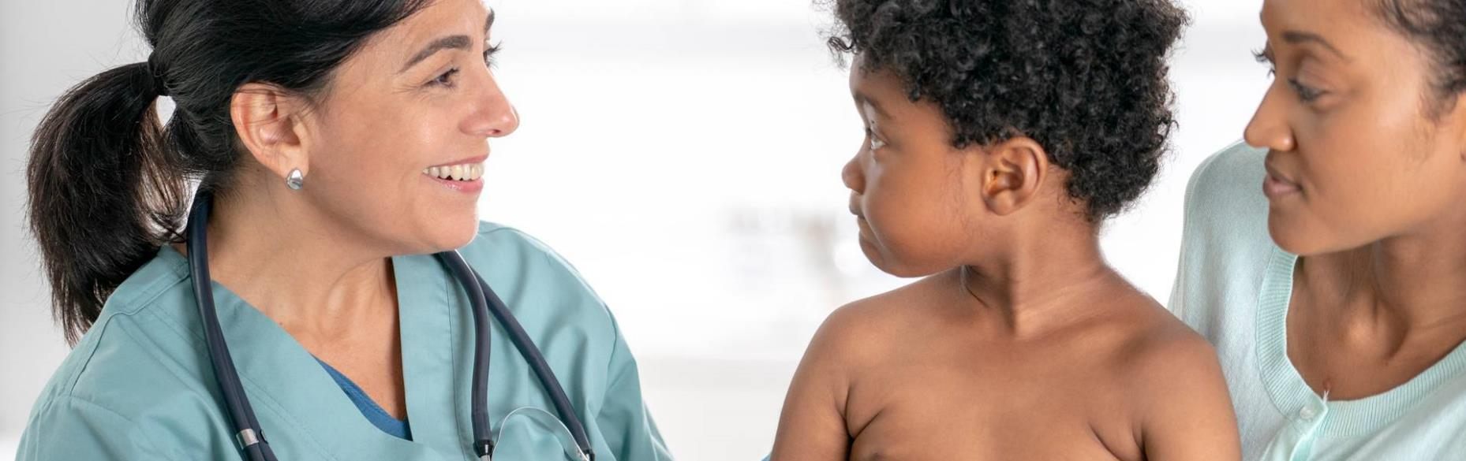
Fast and accurate healthcare system:
A fast and accurate healthcare system is a computer program which enables users to identify simple to large diseases, to connect with doctors through video chat, and to get prescriptions through message.
Fast and accurate Healthcare System are typically designed to:
Provide patient support.
Detect disease with high accuracy.
Take appointment of doctor through video call and get prescription.

Slide 6
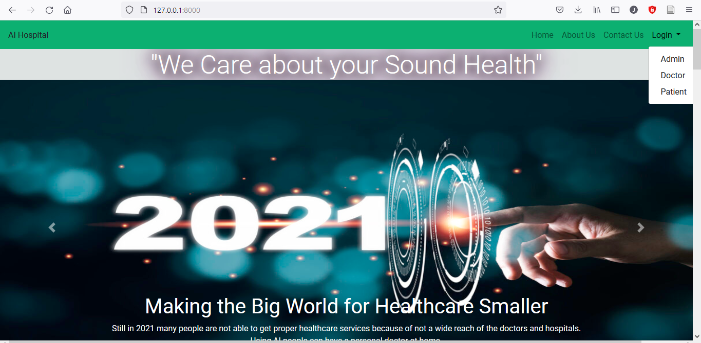
Fast and accurate healthcare system

Slide 7
Problem statements
There are not many sites available in online that allow us to identify multiple disease.
Going to medical or hospital and getting tested are money and time consuming.
Misdiagnosing and medical errors.
There are a lots of data to handle which is not easy for human.
Lacking of efficiency and productivity in providing care delivery.

Slide 8
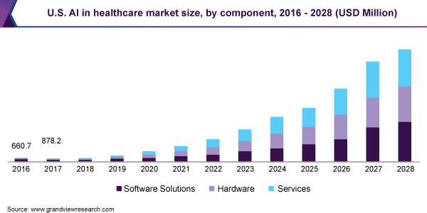
AI healthcare market size

Slide 9
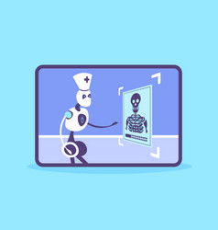
Objectives
HealthMate would be able to serve user with efficiency.
HealthMate will help patient to check if they have selected disease or not.
Patient would be able to take appointment of a doctor.
Doctor can provide his best service through HealthMate.
Doctors will be able to talk patients through video call.

Slide 10


Similar systems
PathAI is developing an AI based health cancer diagnosis technology.
Harvard University's teaching hospital, Beth Israel Deaconess Medical Center is using artificial intelligence to diagnose potentially deadly blood diseases at a very early stage.
Zebra Medical Vision provides an AI-based assistant that receives imaging scans and automatically analyzes them for various clinical findings.

Slide 11
Similar systems (Continued)
BioXcel Therapeutics uses AI to identify and develop new medicines, additionally, the company’s drug re-innovation program employs AI to find new applications for existing drugs or to identify new patients.

Slide 12
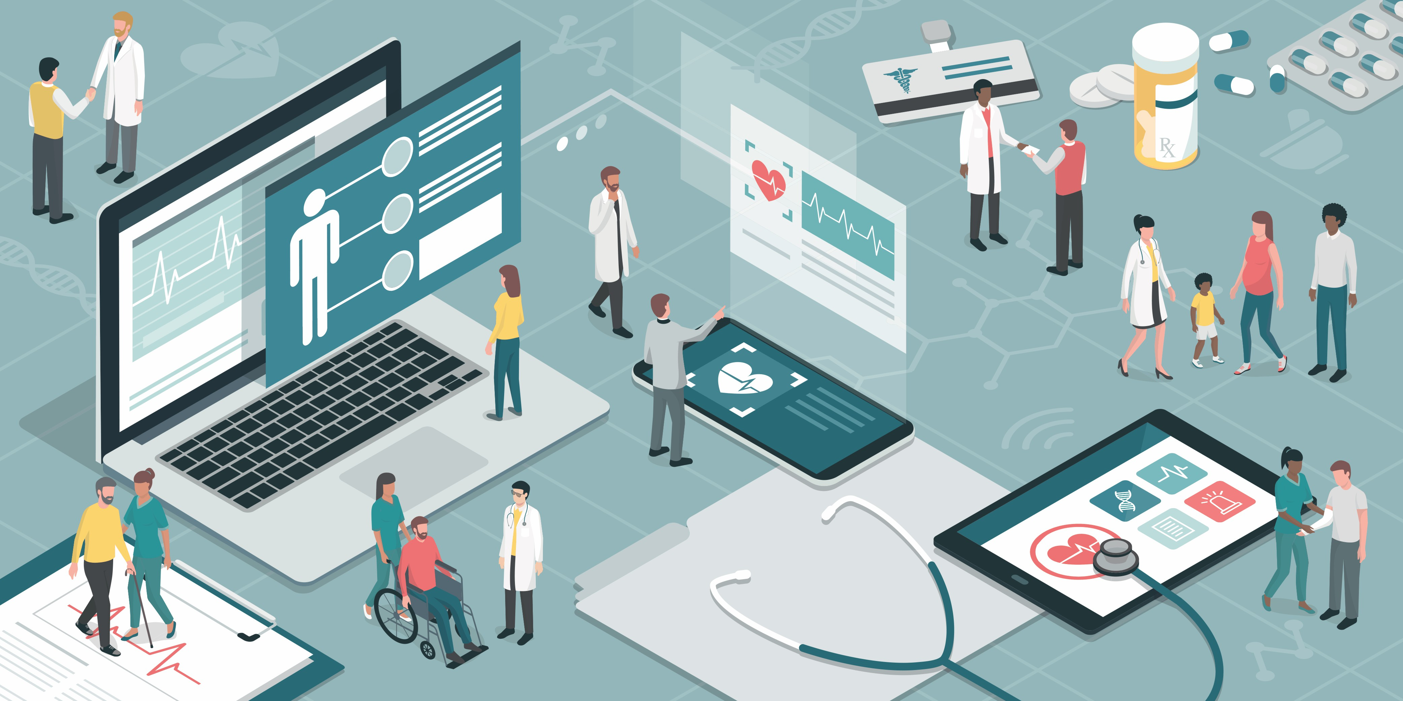
Major contributions
Development of an ‘HealthMate’ system in order to help people to diagnose disease through online without visiting hospital.
To assist pathologist.
To support doctor and patient.
To reduce human error.
To save time.

Slide 13
System Architecture of the HealthMate
User will browse for the site and then choose the sign up option(if new user) or login as doctor/patient/admin.
Patient can upload the lesion and can check disease.
Patient can take a appointment of an available doctor.
Doctor can fix appointment time with patient and meet with patient via video call.
Admin can control the whole system and update the user.

Slide 14
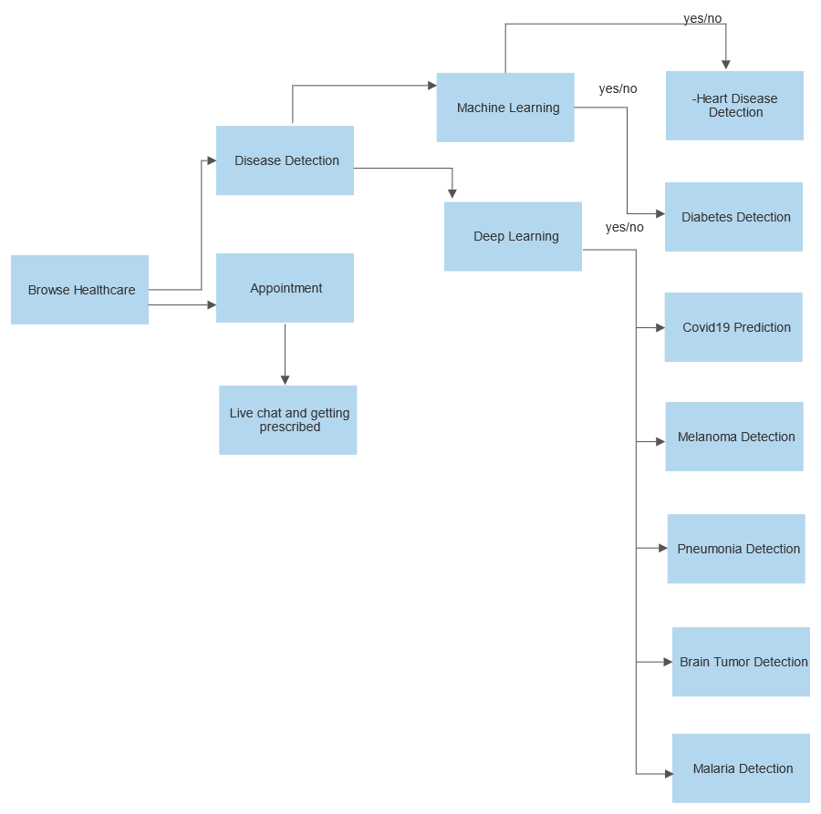
System Architecture of the HealthMate

Slide 15
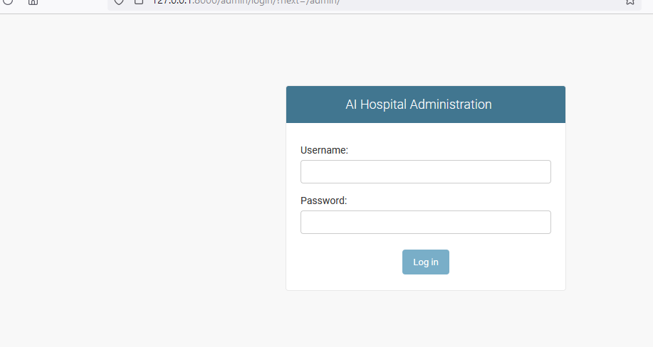
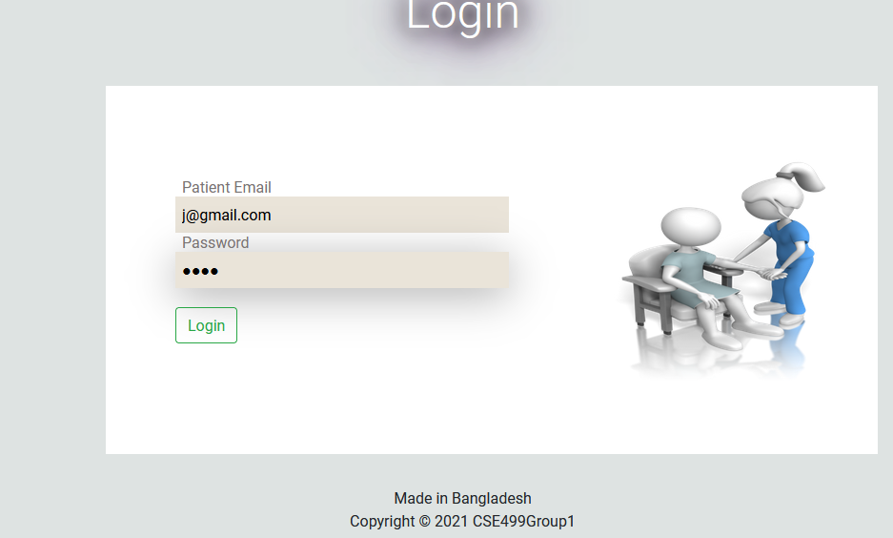
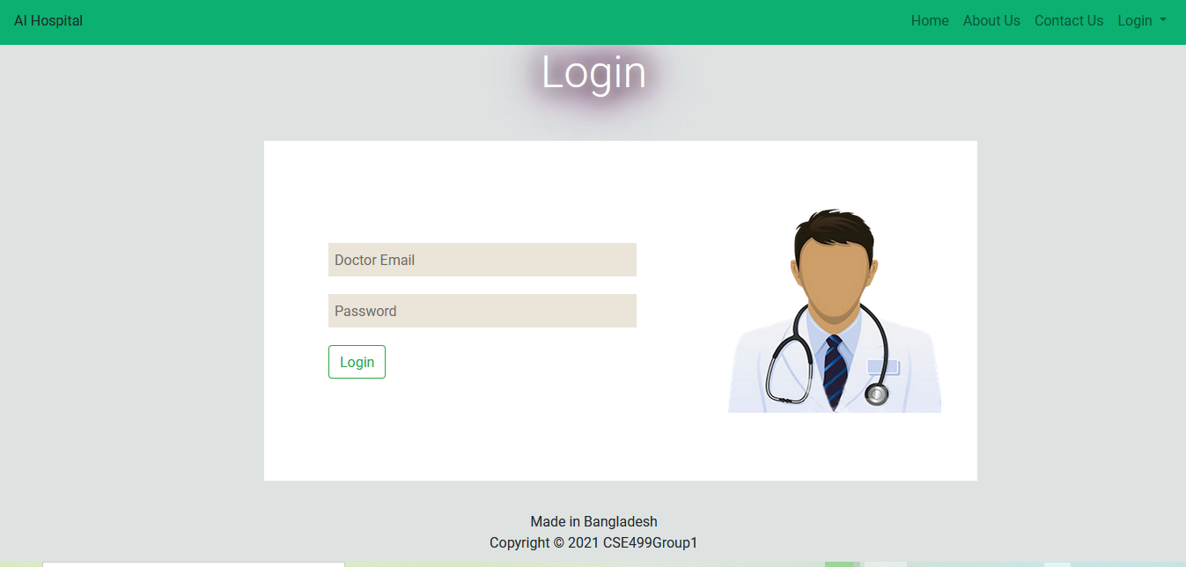
Outcome of Sgining in Page:

Slide 16
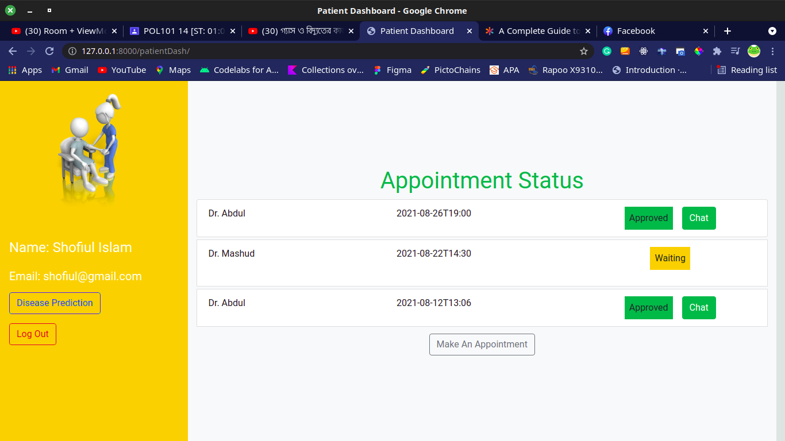
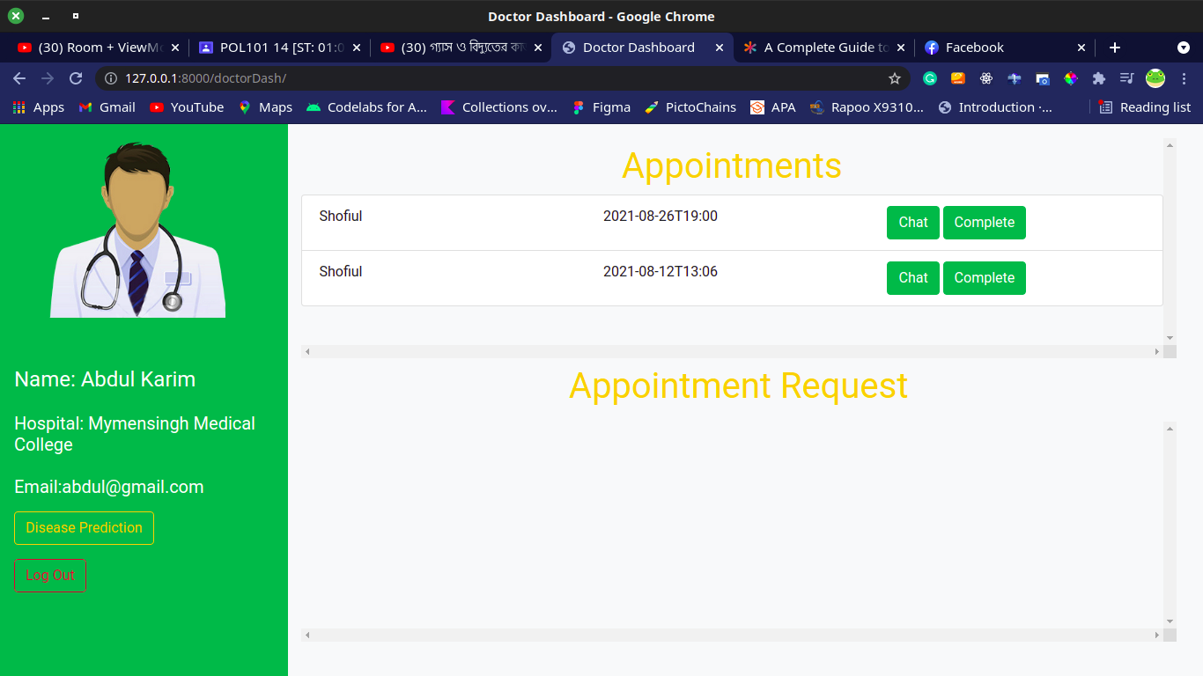
Doctor and Patient Platform:

Slide 17

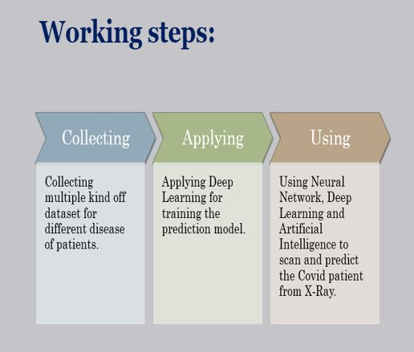
Proposed Model:
For building the model of detect the disease with image or their data, first we downloaded the dataset from Kaggle and other websites.
After that we trained the dataset and build the model, got good accuracy and validation.
We build the model of multiple diseases like Pneumonia, Melanoma, Covid, Diabetes etc.
The working steps are:

Slide 18
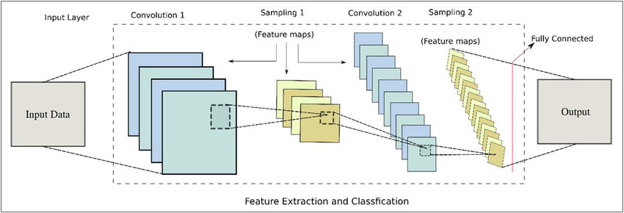
Tools and Algorithms:
Convolutional Neural Network
DENSENET Classification
RESNET Classification
VGG16
Auto-encoder
Random Forest Classification
TENSORFLOW
Scikit-Learn

Slide 19
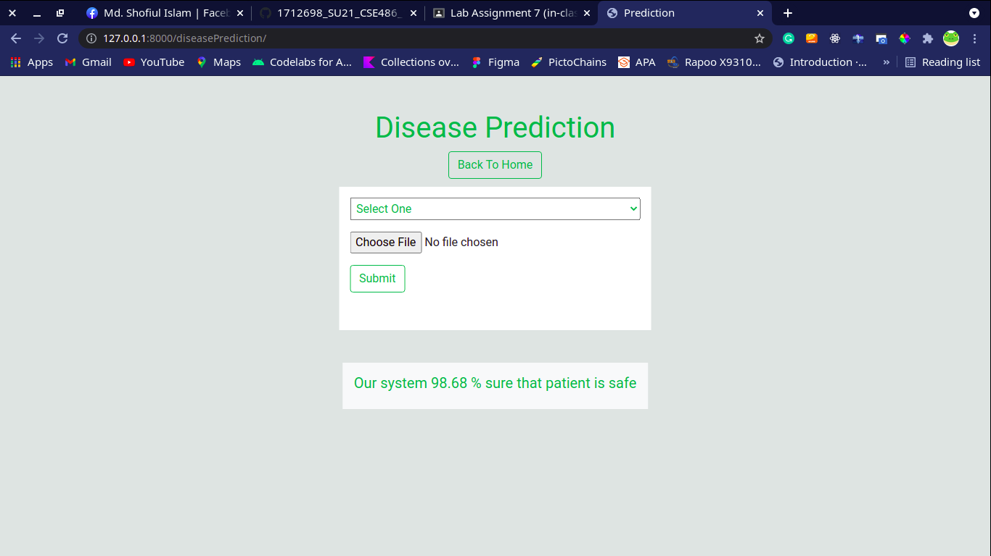
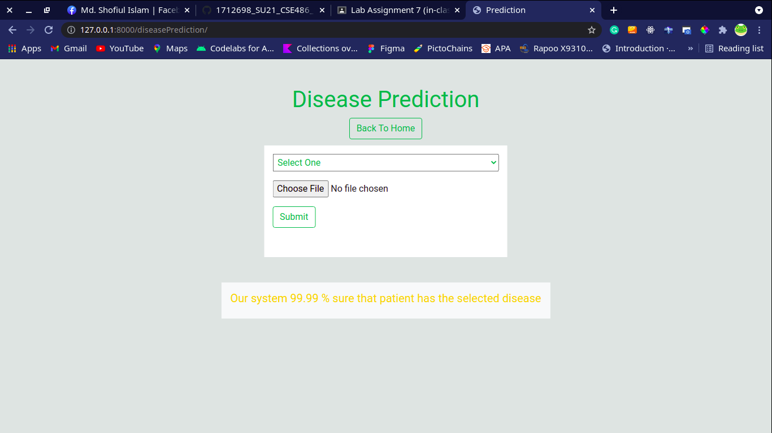
Outcome of the system for Disease Detection:

Slide 20
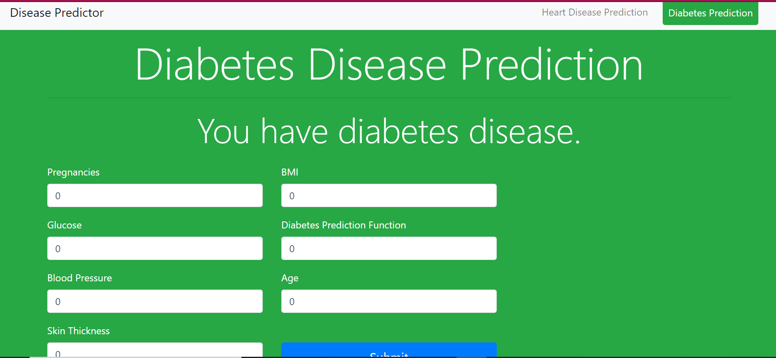
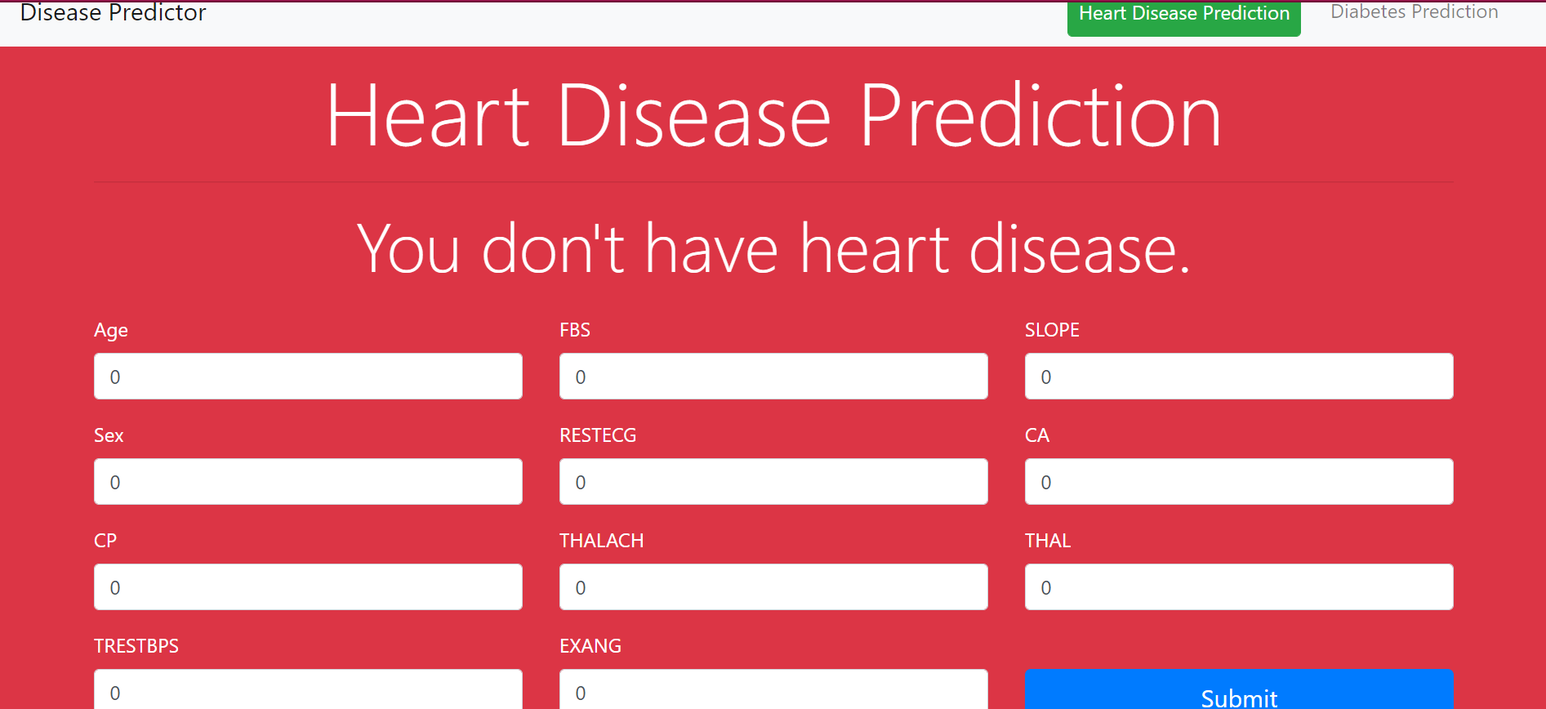
Disease Detect of Heart Disease and Diabetes:

Slide 21
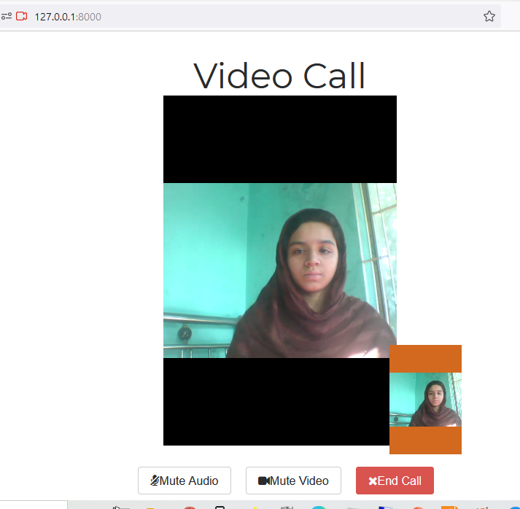
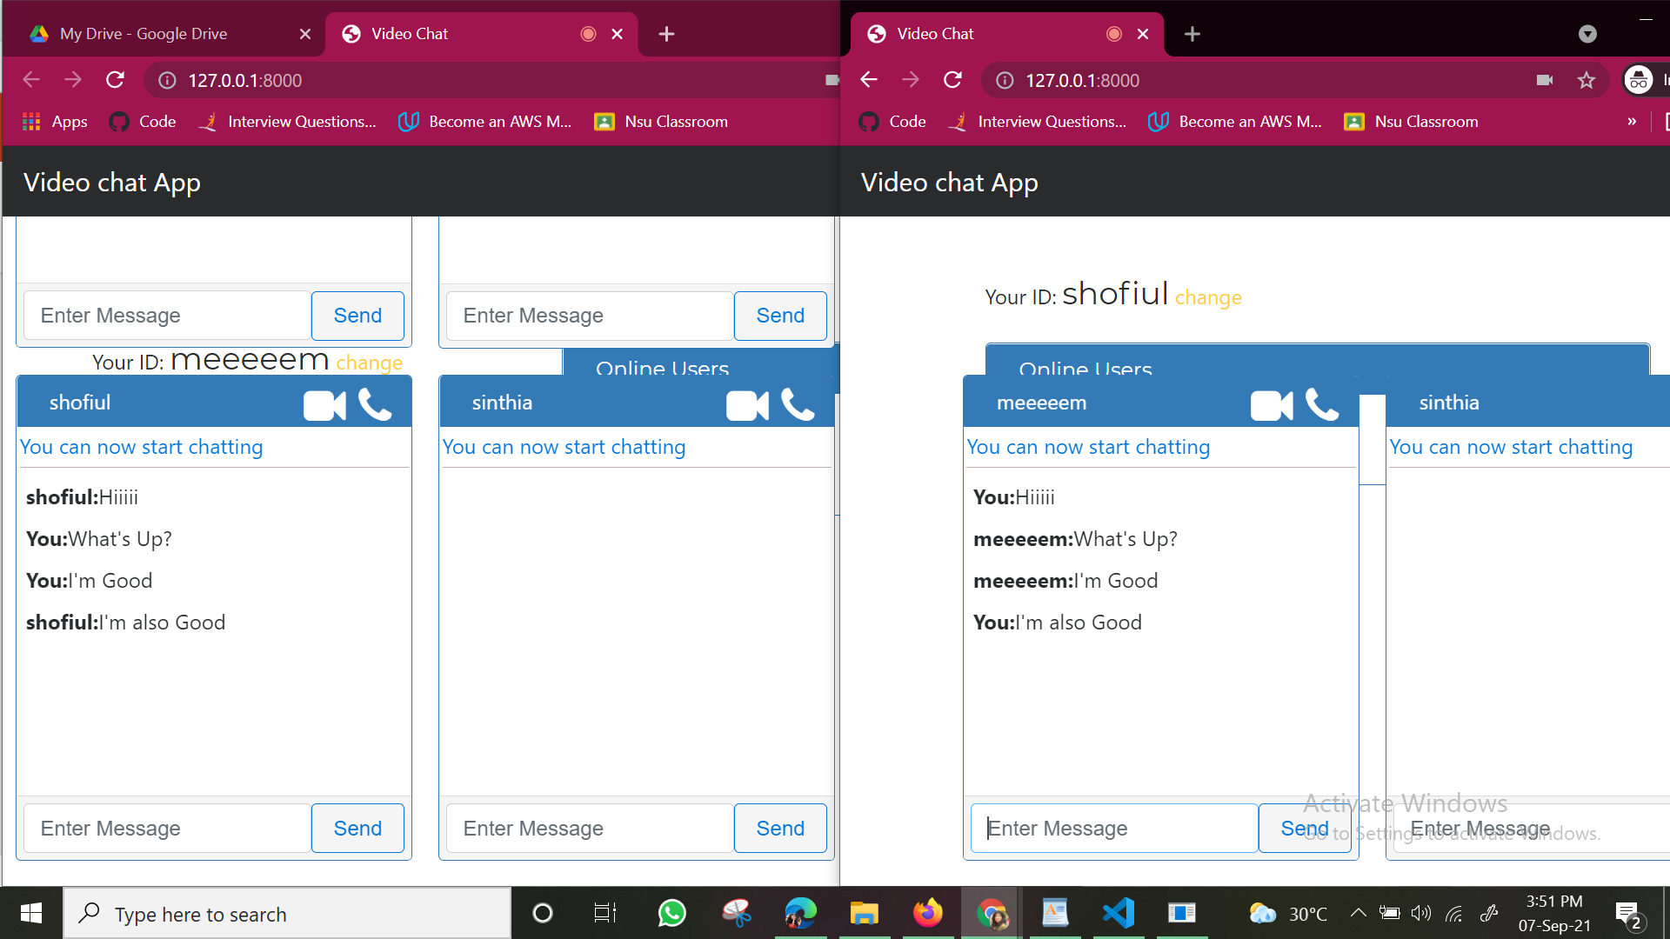
Outcome of the system (VideoChat):

Slide 22
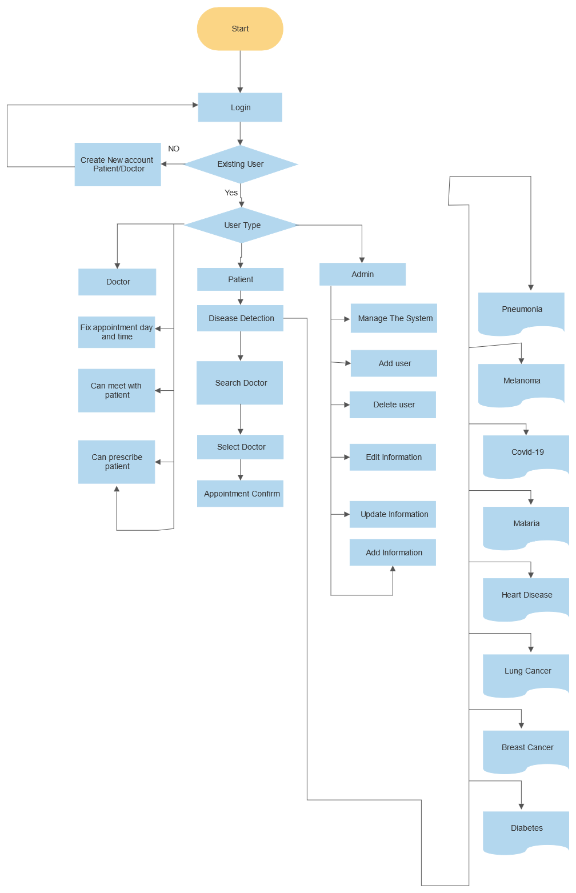
Flowchart of the healthcare system

Slide 23

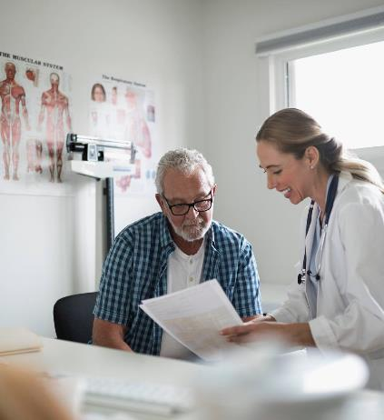
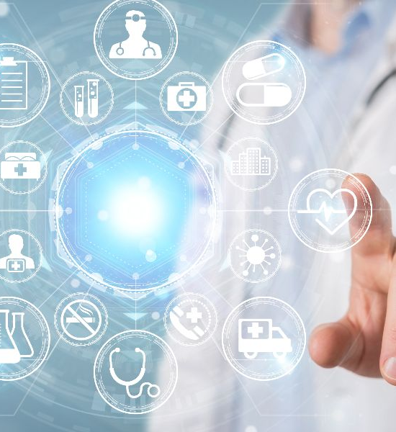
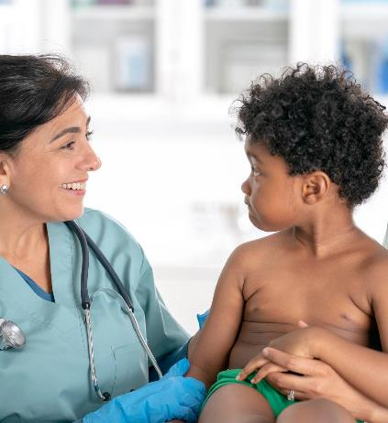
Summary
HealthMate would be able to diagnose diseases at a faster rate than other alternative methods. It can save time for both patients and doctors. HealthMate will improve the relationship between doctors and patients. It will be a reliable and productive web platform for patients and doctors.

Slide 24
Future Work :
Will try to improve the Disease detection model accuracy more higher.
It will become a more efficient system and reliable system to the user.
Our system will be available in website platform.

Slide 25

THANK YOU Everyone...

